Slide 1


Dimensionality reduction
Paulo Czarnewski, ELIXIR-Sweden (NBIS)

Slide 2
A general single cell analysis workflow
Reads
Read QC
Raw counts
Count QC
Normalization
The workflow is dataset-specific:
Research question
Batches
Experimental Conditions
Sequencing method
…
PCA
tSNE / UMAP
Clustering
Diff. Expression
…

Slide 3
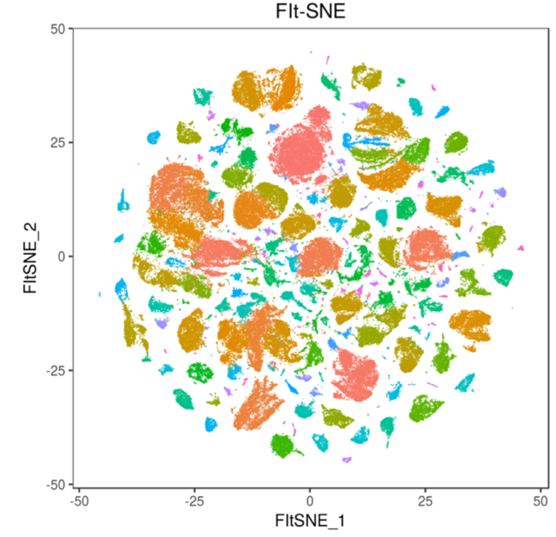
Why dimensionality reduction?
M genes
2 dim.
Simplify complexity, so it becomes easier to work with.
  Reduce number of features (genes)
  In some: Transform non-linear relationships to linear
“Remove” redundancies in the data
Identify the most relevant information (find and filter noise)
Reduce computational time for downstream procedures
Facilitate clustering, since some algorithms struggle with too many dimensions
Data visualization
… and more …
N samples
N samples
non-linear
linear

Slide 4
Some dimensionality reduction algorithms
They can be divided into 3 major groups:
PCA | linear | Matrix Factorization
ICA | linear | Matrix Factorization
MDS | non-linear | Matrix Factorization
Sparce NNMF | non-linear | Matrix Factorization | 2010 | https://pdfs.semanticscholar.org/664d/40258f12ad28ed0b7d4 c272935ad72a150db.pdf
cPCA | non-linear | Matrix Factorization | 2018 | https://doi.org/10.1038/s41467-018-04608-8
ZIFA | non-linear | Matrix Factorization | 2015 | https://doi.org/10.1186/s13059-015-0805-z
ZINB-WaVE | non-linear | Matrix Factorization | 2018 | https://doi.org/10.1038/s41467-017-02554-5
Diffusion maps | non-linear | graph-based | 2005 | https://doi.org/10.1073/pnas.0500334102
Isomap | non-linear | graph-based | 2000 | 10.1126/science.290.5500.2319
t-SNE | non-linear | graph-based | 2008 | https://lvdmaaten.github.io/publications/papers/JMLR_2008.pdf
- BH t-SNE | non-linear | graph-based | 2014 | https://lvdmaaten.github.io/publications/papers/JMLR_2014.pdf
- Flt-SNE | non-linear | graph-based | 2017 | arXiv:1712.09005
LargeVis | non-linear | graph-based | 2018 | arXiv:1602.00370
UMAP | non-linear | graph-based | 2018 | arXiv:1802.03426
PHATE | non-linear | graph-based | 2017 | https://www.biorxiv.org/content/biorxiv/early/2018/06/28/120378.full.pdf
scvis | non-linear | Autoencoder (MF) | 2018 | https://doi.org/10.1038/s41467-018-04368-5
VASC | non-linear | Autoencoder (MF) | 2018 | https://doi.org/10.1016/j.gpb.2018.08.003
… and many more

Slide 5
PCA
Principal Component Analysis

Slide 6
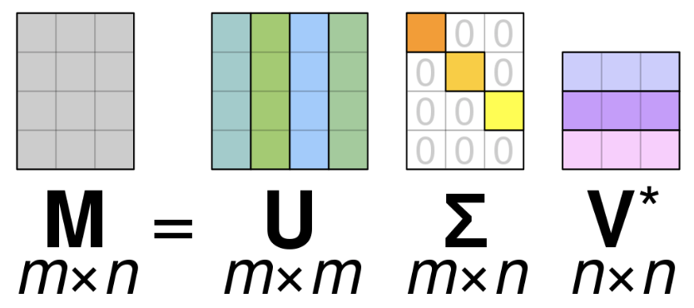
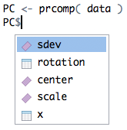
How PCA works
It is a LINEAR algebraic method of dimensionality reduction.
It is a case inside Singular Value Decomposition (SVD) method (data compression)
Any matrix can be decomposed as a multiplication of other matrices (Matrix Factorization).
samples
PCs
samples
PCs
genes
genes
samples
samples
Original data
Center
Rotation
Planar rotation
Scaling
data
PC$rotation
PC$x

Slide 7
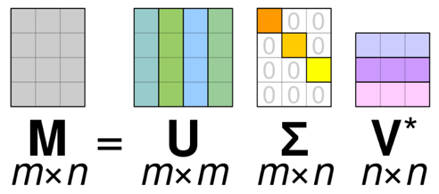
How PCA works
original data (Z-score)
(0,0)
PC1
PC2
gene_B
gene_A
rotation to another
coordinate system
PCA
percentage
of variance
explained
PC2
rotation
PC1
PC2
PC1

Slide 8
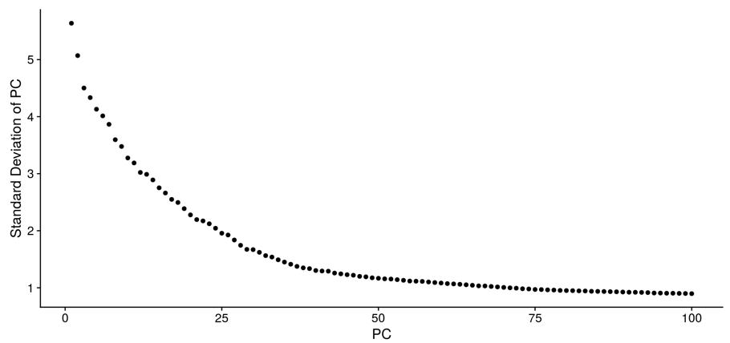
How PCA works
PC1 explains >98% of the variance
1 PC thus represents 2 genes very well
“Removing” redundancy
PC2 is nearly insignificant in this example
Could be disregarded
PC1
PC2
In real life …
percentage
of variance
explained
PC1
PC2
Seurat Pipeline

Slide 9
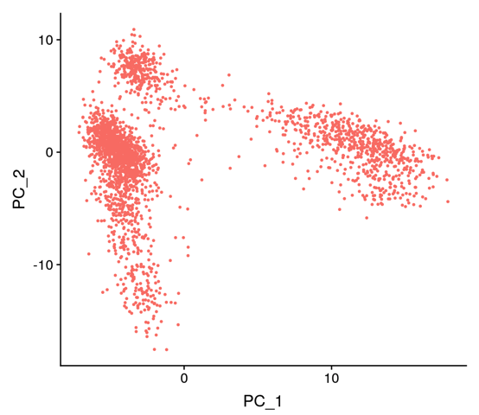
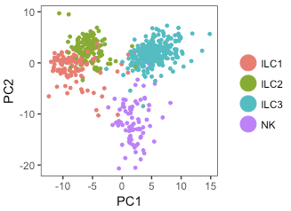
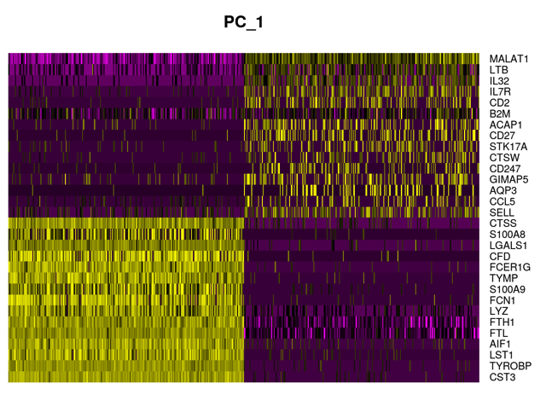
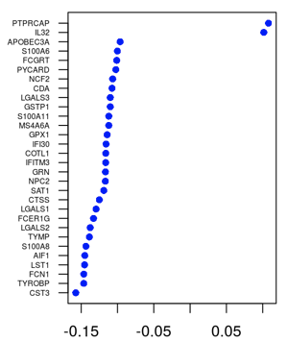
PCA in single cell data
PC1 and PC2 are commonly correlated to sequencing depth and cell heterogeneity/complexity
(but not always …)
PC1
Seurat Pipeline / Forkel et all 2015

Slide 10
PCA: Summary
To keep in mind:
It is a LINEAR method of dimensionality reduction
It is an interpretable dimensionality reduction
Data is usually SCALED prior to PCA (Z-score | see ScaleData in the Seurat)
The TOP principal components contain higher variance from the data
Can be used as FILTERING, by selecting only the top significant PCs
  PCs that explain at least 1% of variance
  Jackstraw of significant p-values
  The first 5-10 PCs
Problems:
It performs poorly to separate cells in 0-inflated data types (because of it non-linearity nature)
Cell sizes and sequencing depth are usually captured in the top principal components

Slide 11
A very brief intro to graphs

Slide 12
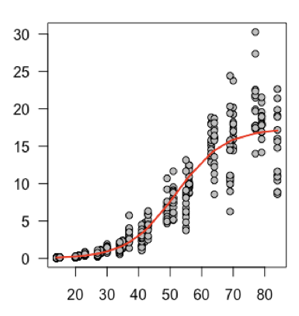
Graphs
Each dot is a cell (or a gene)
Each line represents a connection between 2 cells
Each connection can be weighted as a proximity between cells
- Correlation (high and positive)
- Euclidean distance (low)
- etc.
This is a PLOT
This is GRAPH
(a.k.a. network)
Graph-based dimensionality reduction algorithms can be divided into 2 main steps:
  1. Construct a weighted graph based on the top k connections
  (a.k.a. k-nearest neighbors, KNN)
  2. The low dimensional layout of the graph is computed and optimized

Slide 13
tSNE
t-Stochastic Neighborhood Embedding

Slide 14

How t-SNE works
It is a graph-based NON-LINEAR dimensionality reduction
Manifold:
distance in PCA space
(euclidean distance)
distance in t-SNE space
In other words, t-SNE calculates the distances based on the distance to the neighbor cell
Maaten et al (2008) Journal of Machine Learning Research

Slide 15
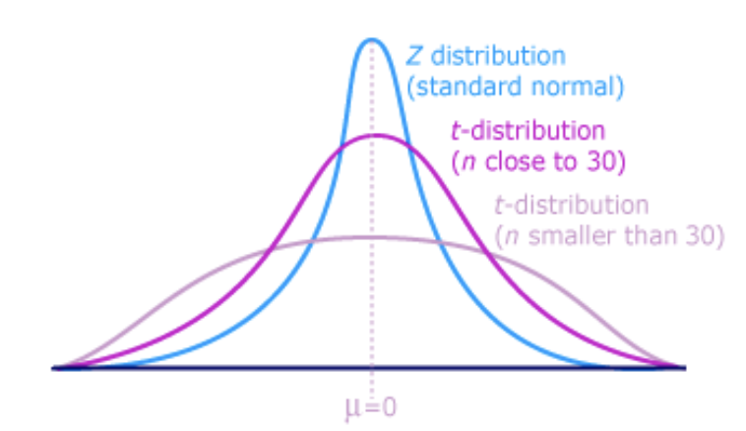
How t-SNE works
High
dimension
Low
dimension
j
j
i
i
t-distribution
= p_{j|i}
= q_{j|i}
p_{j|i} and q_{j|i} measure the conditional probability that a point i would pick point j as it’s nearest neighbor, in high (p) and low (q) dimensional space respectively.

Slide 16
How t-SNE works
Higher KL divergence
(cost / error)
iterations
gene B
iterations
iterations
gene A
Lower KL divergence
(cost / error)
The same concept applies to embedding into 2 dimensions

Slide 17
t-SNE hyper-parameters
Barnes-Hut’s tSNE implementation - O(n log n)
Rtsne & Seurat & viSNE (MATLAB)
The definition of the t-SNE and the chances of converging correctly depends on the hyper-parameters (“tuning” parameters).
t-SNE has over 10 hyper-parameters that can be optimized for your specific data.
The most common hyper-parameters are:
Perplexity
Number of iterations
Learning rate
Theta (for BH t-SNE)
Check this link:
Maaten (2014) Journal of Machine Learning Research
https://distill.pub/2016/misread-tsne/

Slide 18
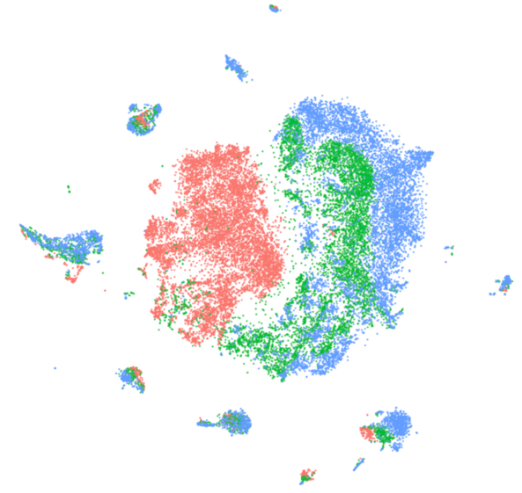
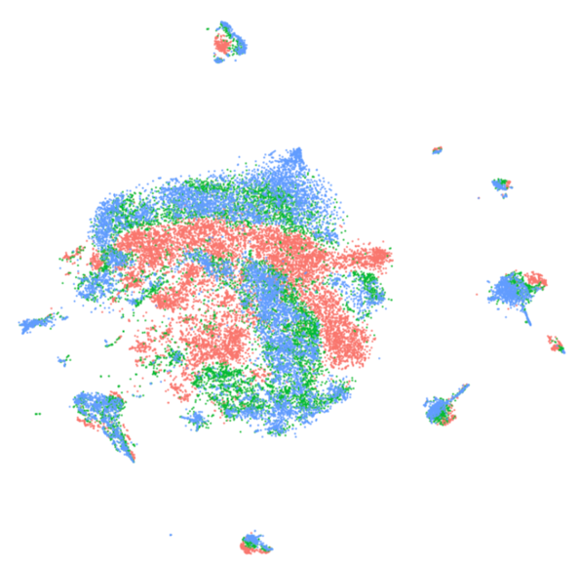
Important notes about t-SNE
Unlike PCA, it is a stochastic algorithm, so it will never produce the same output (unless you use a seed() to lock the random estimators).
The cost function never reaches the minima, and it is not an indicator how good the graph looks.
The cost function in t-SNE minimizes the distance between similar points (and ignore the distant ones – local embedding)
The distances within a group are slightly meaningful, but not between groups!
To add more samples, you need to re-run the algorithm from start.
Converged successfully
Failed to converge

Slide 19
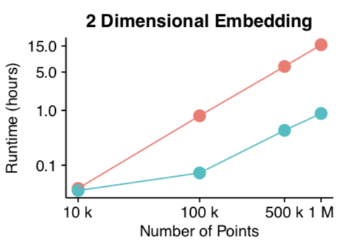


Efficient t-SNE implementation
Fast Fourier Transform-accelerated Interpolation-based t-SNE - O(n)
Linderman et al (2017) BioRxiv
250k cells
1 hour
Linderman et al 2017 / Seurat Pipeline

Slide 20
t-SNE: summary
To keep in mind:
It is a NON-LINEAR method of dimensionality reduction
It is the current GOLD-STANDARD method in single cell data (including scRNA-seq)
Can be run from the top PCs (e.g.: PC1 to PC10)
Problems:
It does not learn an explicit function to map new points
It’s cost function is not convex – This means that the optimal t-SNE cannot be computed
Too many hyper-parameters to be defined empirically (dataset-specific)
It does not preserve a global data structure (only local)

Slide 21
UMAP
Uniform Manifold Approximation and Projection

Slide 22
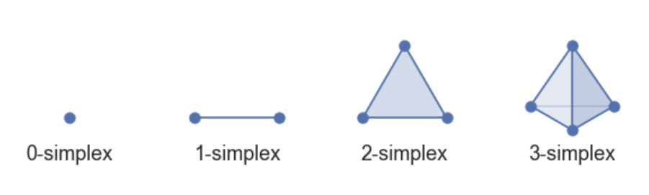
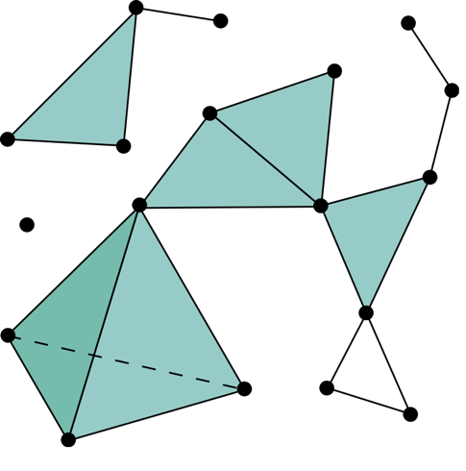
How UMAP works
It is based on topological structures in multidimensional space (simplices)
Points are connected with a line (edge) if the distance between them is below a threshold:
- Any distance metric can be used (euclidean)
(0,1)
…
(g1,g2,g3,g4,g5, …)
This way, by constructing the simplicial complexes beforehand allows UMAP to calculate the relative point distances in the lower dimension
(instead of randomly assigning as in tSNE)
McInnes et al (2018) BioRxiv

Slide 23
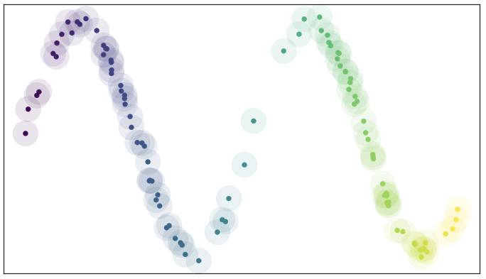
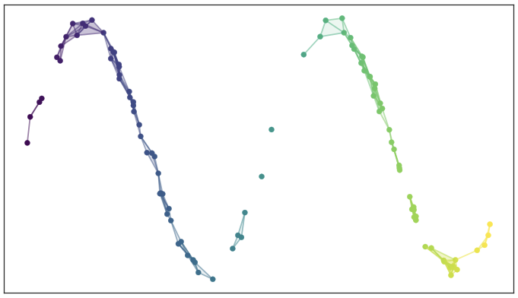
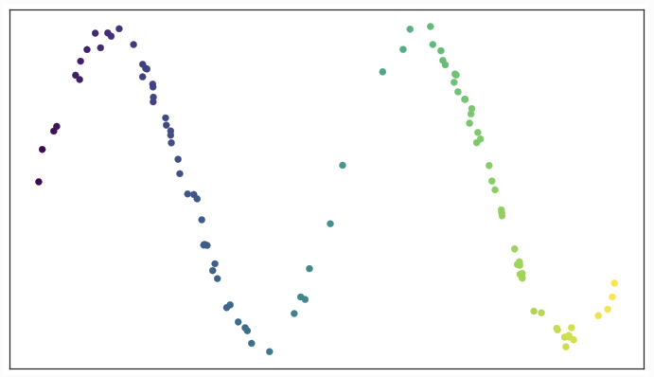
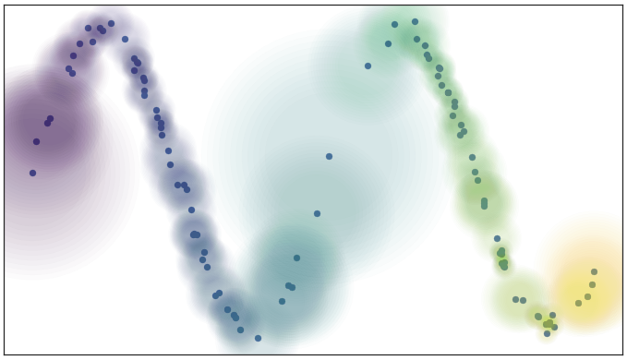
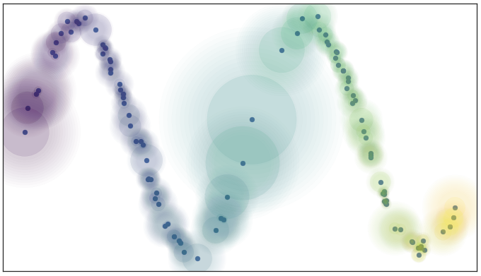
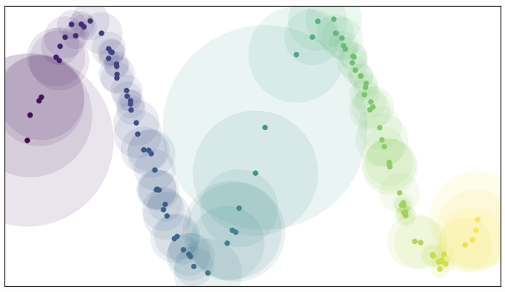
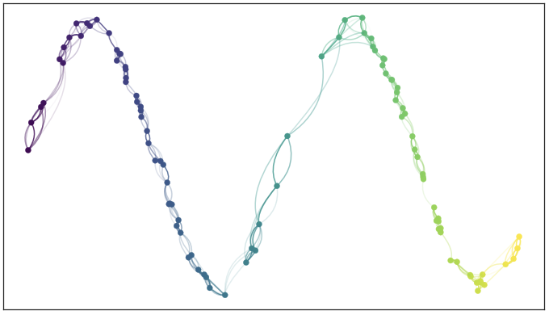
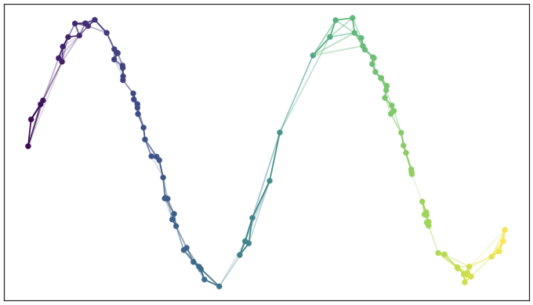
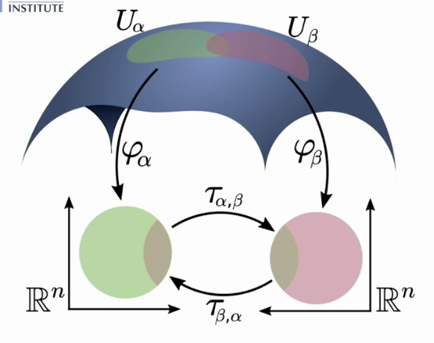
How UMAP works
The distance in the manifold are the same, but not in the REAL space.
The distance is now “variable” in the REAL space for each point (t-SNE was fixed)
McInnes et al (2018) BioRxiv
https://umap-learn.readthedocs.io/en/latest/how_umap_works.html

Slide 24
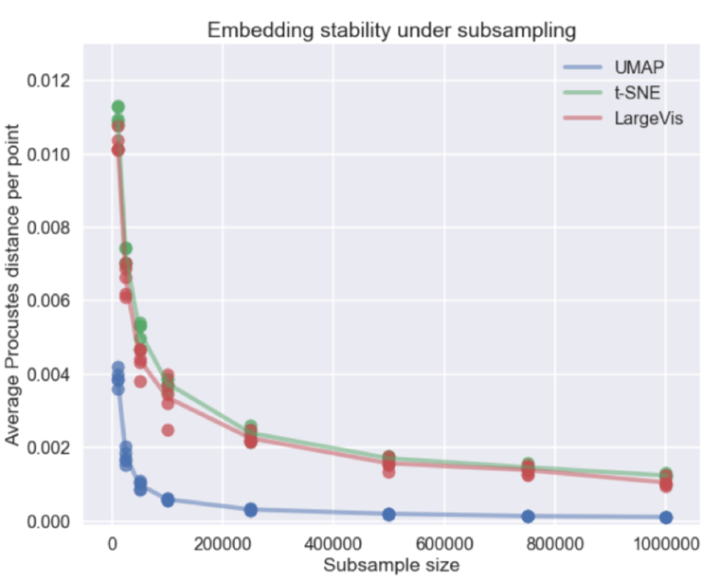
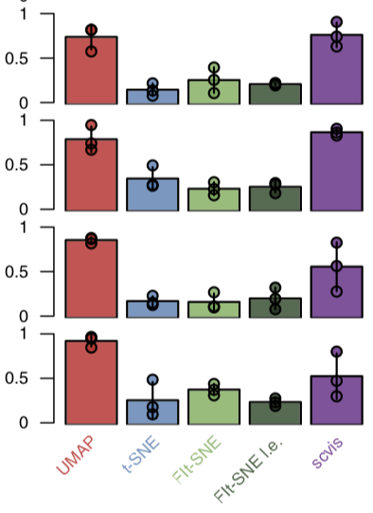
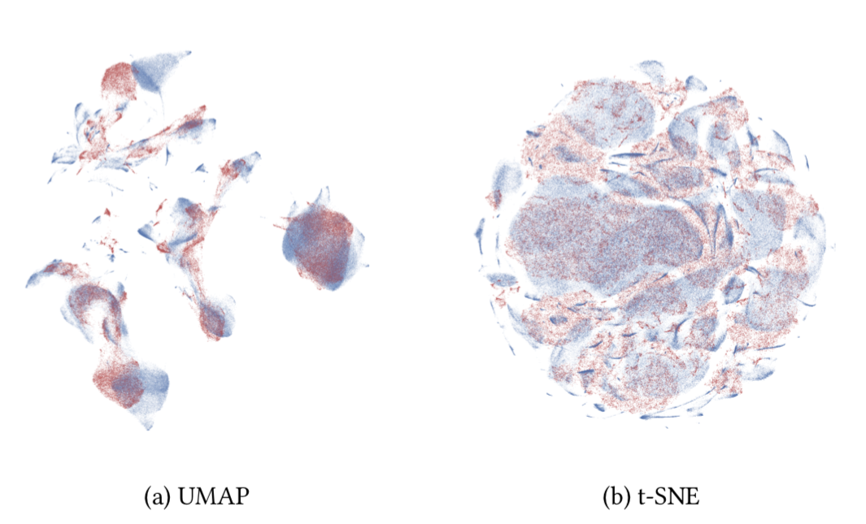
UMAP
gene A
gene A
Since UMAP learns the global data structure and is less dependent on random initiators (like t-SNE), it can recreate low dimensional embedding regardless of the dataset size.
Correlation mapping positions
Cell number
McInnes et al (2018) BioRxiv
Becht & McInnes et al (2019) Nat Biot

Slide 25
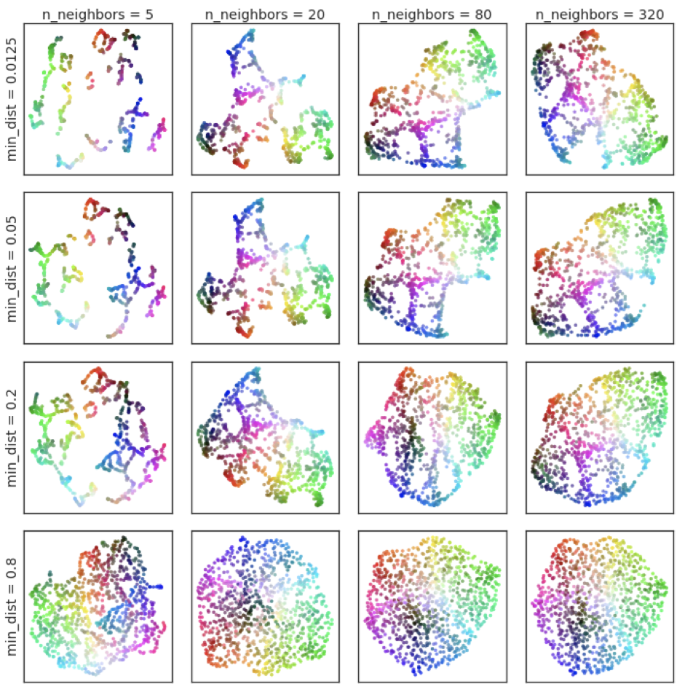
UMAP hyper-parameters
UMAP assumes that there is a manifold in the dataset, it could also tend to cluster noise.
As for t-SNE, checking the parameters is also important.
Embedding of random noise
McInnes et al (2018) BioRxiv
https://umap-learn.readthedocs.io/en/latest/parameters.html

Slide 26
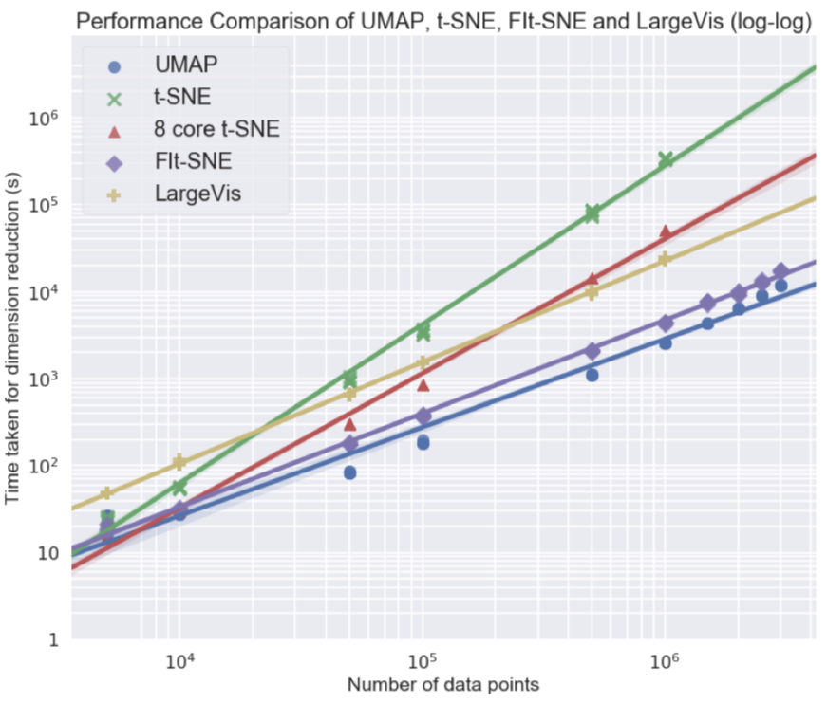
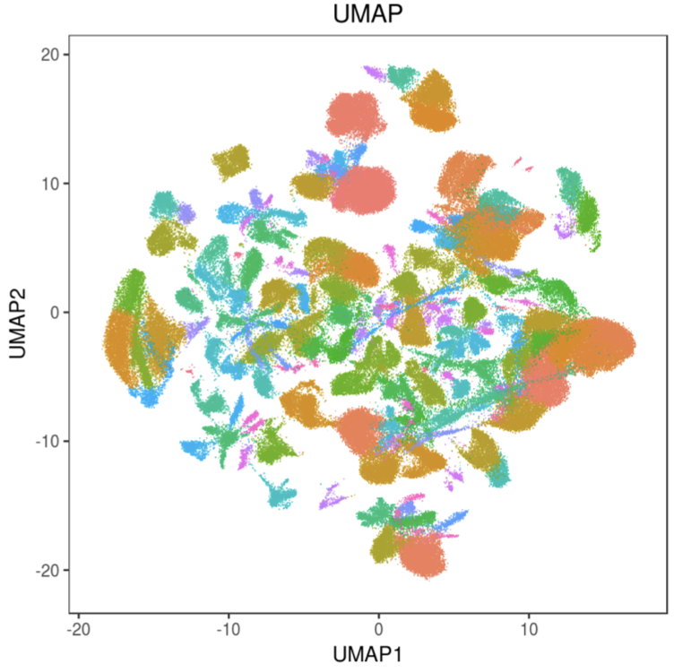
UMAP hyper-parameters
UMAP’s mathematical improvements allows much faster computations compared to current state-of-the-art methods.
250k cells
7 min
McInnes et al (2018) BioRxiv
Becht & McInnes et al (2019) Nat Biot

Slide 27
UMAP: Summary
To keep in mind:
It is a NON-LINEAR graph-based method of dimensionality reduction
Very efficient - O(n)
Can be run from the top PCs (e.g.: PC1 to PC10)
Can use any distance metrics!
Can integrate between different data types (text, numbers, classes)
It is no longer completely stochastic as t-SNE
Defines both LOCAL and GLOBAL distances
Can be applied to new data points
McInnes et al (2018) BioRxiv
Becht & McInnes et al (2019) Nat Biot

Slide 28
Wrap-up

Slide 29
Single cell workflows
Seurat v3
PCA
ICA
-
tSNE (BH, Flt)
UMAP
-
Diff. Maps
-
PHATE
-
Scater
PCA
-
MDS
tSNE (BH)
UMAP
-
Diff. Maps
-
-
-
Pagoda v2
PCA
-
-
tSNE (BH)
-
LargeVis
Isomap
-
-
-
Monocle v3
PCA
ICA
-
tSNE (BH)
UMAP
-
-
DDRTree
-
SimplePPT
Paper comparing lots of dimensionality reduction techniques: https://www.biorxiv.org/content/biorxiv/early/2018/06/28/120378.full.pdf

Slide 30
Thank you!
Paulo Czarnewski, ELIXIR-Sweden (NBIS)

Slide 31
Exercise time !!!

Slide 32
Exercises: free exploration
Follow the initial steps of Data Integration Lab
pancreas.data <- readRDS(file="session-integration_files/pancreas_expression_matrix.rds")
metadata <- readRDS(file="session-integration_files/pancreas_metadata.rds")
pancreas <- CreateSeuratObject(pancreas.data, meta.data = metadata)
pancreas <- NormalizeData(pancreas, verbose = FALSE)
pancreas <- FindVariableFeatures(pancreas, selection.method = "vst", nfeatures = 2000, verbose = FALSE)
pancreas <- ScaleData(pancreas, verbose = FALSE)
pancreas <- RunPCA(pancreas, npcs = 30, verbose = FALSE)
pancreas <- RunTSNE(pancreas, reduction = "pca", dims = 1:30)
pancreas <- RunUMAP(pancreas, reduction = "pca", dims = 1:30)

Slide 33
Exercises: free exploration
obj <- RunPCA( obj )
obj @ reductions $ pca @ cell.embeddings
@ feature.loadings
@ stdev
obj <- RunTSNE( obj )
obj @ reductions $ tsne @ cell.embeddings
reduction="PCA" dims=1:20 perplexity=30 max_iter=1000 num_threads=0 theta=0.2
obj <- RunUMAP( obj )
obj @ reductions $ umap @ cell.embeddings
reduction="PCA" dims=1:20 n.neighbors=50
n.epochs=200 min.dist=0.0001
PCAPlot(obj)
ElbowPlot(obj)
JackStraw(obj)
JackStrawPlot(obj)
PCASigGenes(obj)
PCA
tSNE
TSNEPlot(obj)
UMAP
UMAPPlot(obj)

Slide 34
Exercises: free exploration
Follow the initial steps of Data Integration Lab
PCA: Which genes separate PC1? Which genes separate PC2?
PCA: Using the Elbow method, how many PCs contain over 1% standard deviation?
tSNE: What happens if you use only 5 PCs as input for your tSNE?
tSNE: What happens if you increase perplexity to 50 ? And with 5?
tSNE: What happens if you decrease theta? Try between 0.1 - 0.2.
tSNE: What happens if decrease the number of iteration to 400?
UMAP: What happens if you set 100 neighbors?
UMAP: can reduce your data to 5 dimensions (instead of only 2)?
UMAP: what happens if you reduce the minimum distance to 0.001?

